Slide 1

MSE 311: Thermodynamics of Materials
Lecture-03:
Entropy and Carrot efficiency
Weishu Liu
Department of Materials Science and Engineering
Southern University of Science and Technology (SUSTech)
Email: liuws@sustech.edu.cn
Office: North Tower, Rm310
Sep 7，2018
Prof. W.S. Liu | 1

Slide 2

4. Principle of Carnot
Chapter 3
Introduction to the thermodynamics of materials,
5th or 6th edition, by David R. Gaskell, Talor & Francis Press, 2018

Slide 3
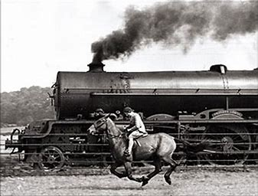
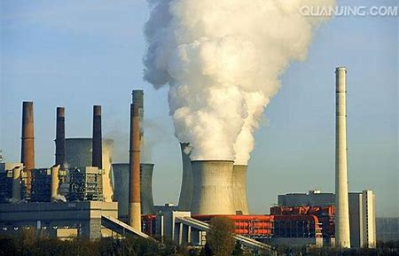

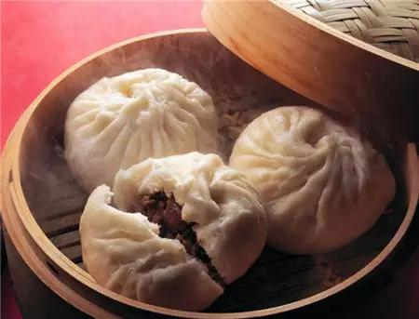
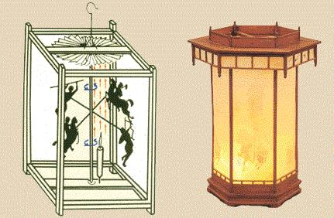

“Efficiency” VS “Delicious + Joy”
Notes:
Recall the concept of equilibrium

Slide 4
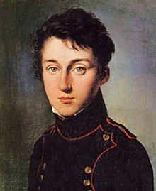
Principle of Carnot
Q_{H}
Q_{c}
Heat Source
Heat
Engine
Cold
Sink
W
1824: Principle of Carnot
Reversible heat engines have the maximum efficiency.
The efficiencies of all the reversible heat engines operating between the same two reservoirs are the same.
The efficiency of an irreversible heat engine is always less than the efficiency of a reversible one operating between the same two reservoirs.
Nicolas L. S. Carnot
French physics
1796-1832
"father of thermodynamics"
A heat engine must working between two different temperatures, the work is obtained as the heat flows from the hot end to the cold end.

Slide 5
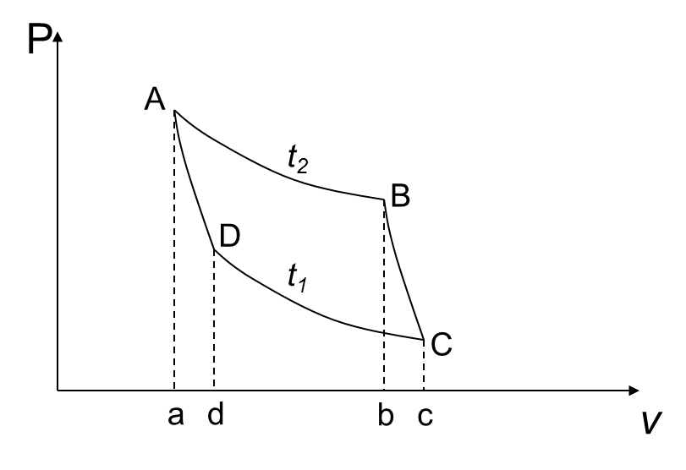
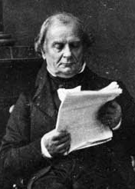
Carnot cycles in Clapeyron graph
Benoît Clapeyron
1799-1864
French
A-B: Reversible isothermal expansion.
B-C: Reversible Adiabatic expansion.
C-D: Reversible isothermal compression.
D-A: Reversible adiabatic compression.
one of the founders of thermodynamics

Slide 6
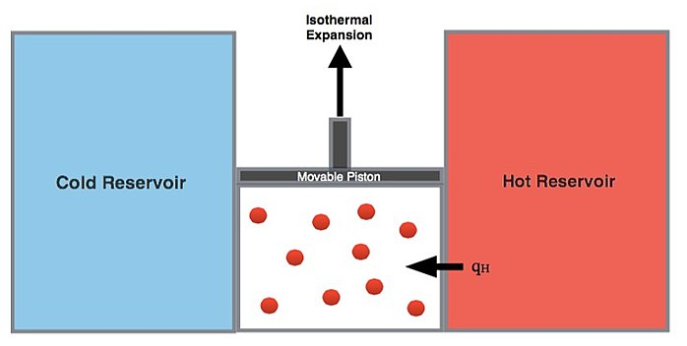
Carnot Cycle
-Process A to B (Isothermal expansion)
∆T=0
For ideal gas, the internal energy remains the same.
V_{A} < V_{B}, ω₁ is positive (the system perform work); q₂ is positive (heat is transferred to the system.)
q2
PV=const.
q1

Slide 7
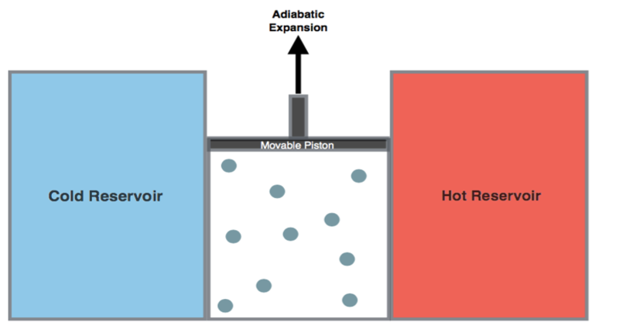
Carnot Cycle
-Process B to C: Adiabatic expansion
Adiabatic means no heat transfer between the system and surroundings
V_{c} > V_{b}, ω₂ is positive (the system perform work).
q2
P V ^{γ}=const.
q1

Slide 8
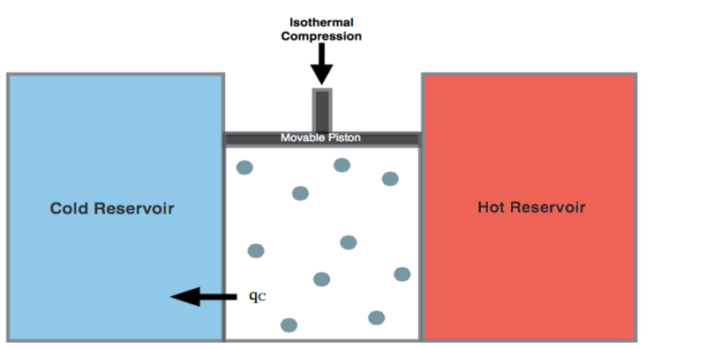
Carnot Cycle
-Process C to D: Isothermal compression
Isothermal means constant temperature. For ideal gas, the internal energy remains the same.
V_{C} > V_{D}, ω₃ is negative (work is performed on the system);
q₁ is negative (heat is transferred out of the system.)
q2
On mole ideal gas.
q1
Prof. W.S. Liu | 8

Slide 9
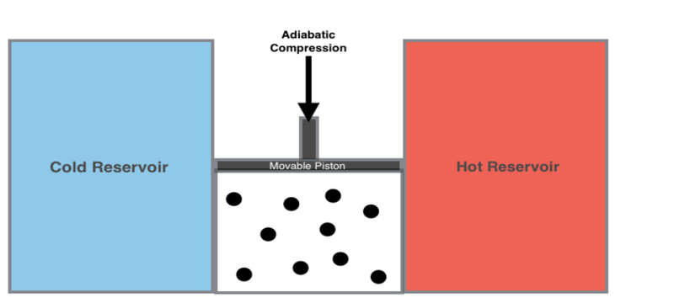
Carnot Cycle
-Process D to A : Adiabatic compression
Adiabatic means no heat transfer between the system and surroundings
V_{D} > V_{A}, ω₄ is negative
(work is performed on the system).
q2
q1

Slide 10
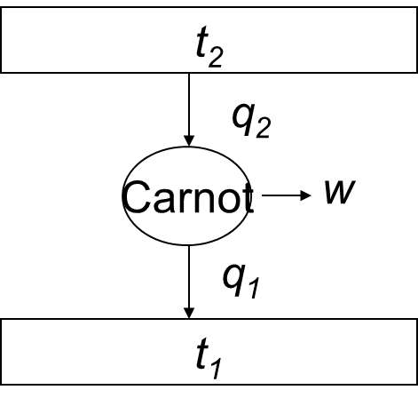
Carnot Cycle
On mole ideal gas.
>0
>0
w = w 1 + w 2 + w 3 + w 4
Efficiency of the Carnot cycle:
w =q₂ –q₁

Slide 11
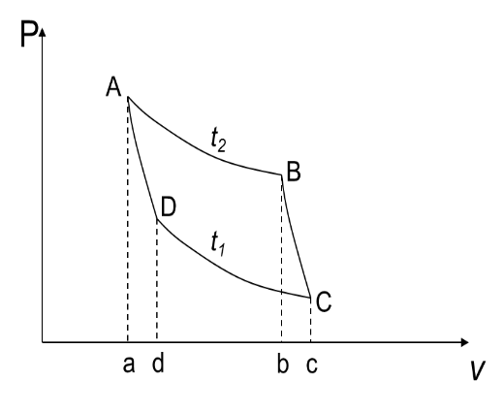
Properties of Heat Engine
One mole ideal gas.

Slide 12
Properties of Heat Engine
One mole ideal gas.

Slide 13
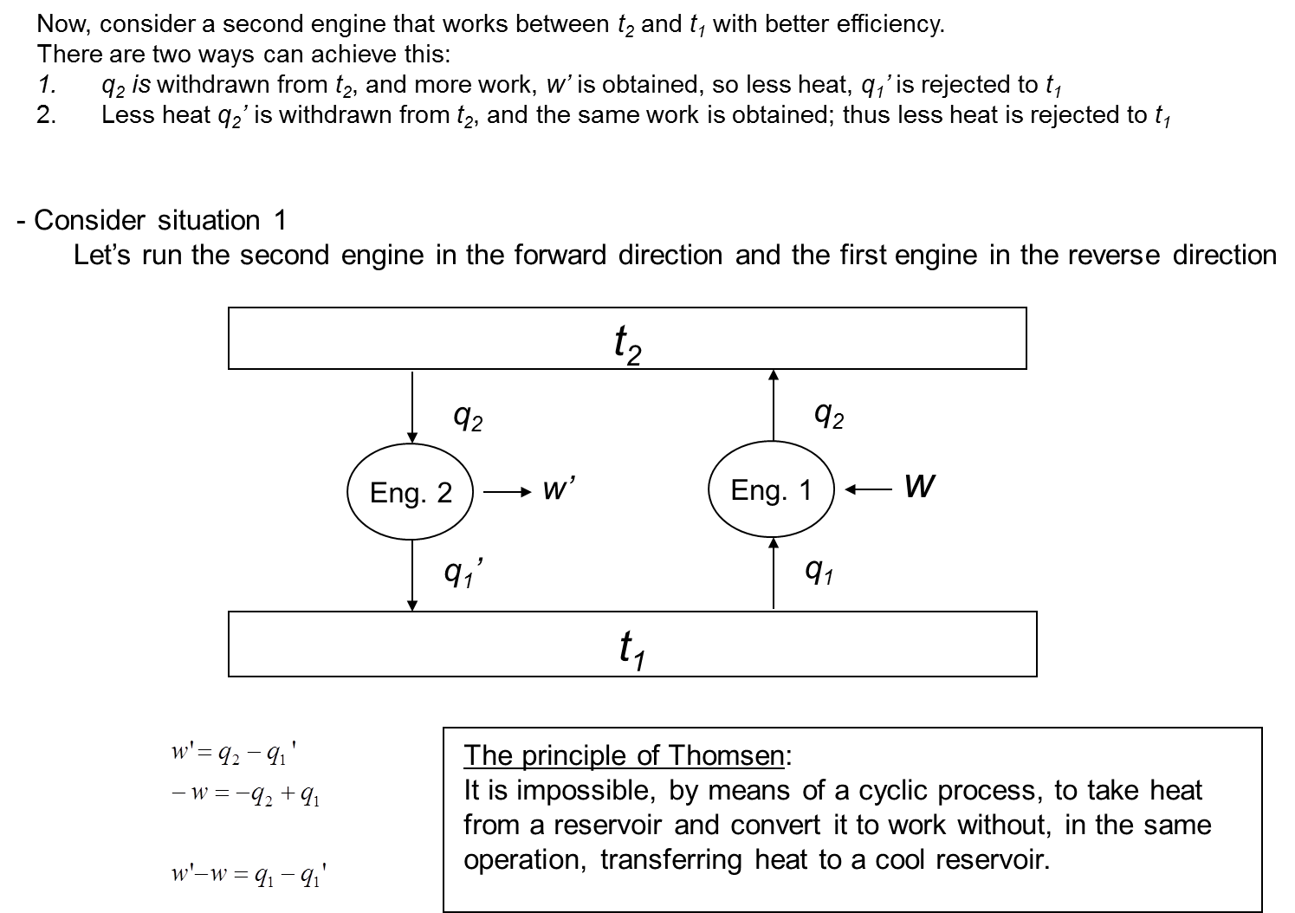
Prove of Carnot Principle
Consider a Eng1, Carnot engine
And assume Eng2 that works between t₂ and t₁ with better efficiency than Eng1
Situation 1 (q₂ is the same for both engine )
For Eng2, q₂ is withdrawn from t₂, and more work, w’ is obtained, so less heat, q1’ is rejected to t₁
Let’s run the Eng 2 in the forward direction and the Eng.1 in the reverse direction
Heat engine
Heat pump
That is, an amount of work (w' – w ) has been obtained from a quantity of thermal energy (q1 − q1) without any other change occurring

Slide 14
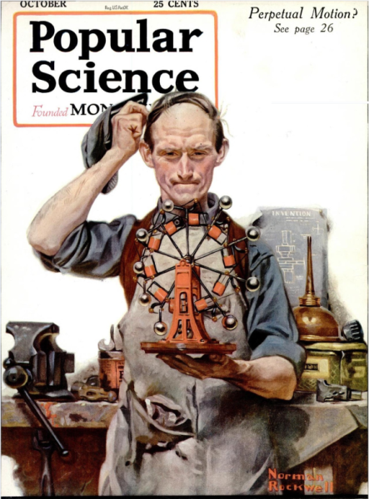
Perpetual motion ?
Although this conclusion doesn’t contravene the First Law of Thermodynamics, it is contrary to human experience.
Such a process corresponds to perpetual motion of the second kind ; that is, heat is converted to work without leaving a change in any other body.
Heat engine
Heat pump
Perpetual motion of the 1nd kind :
the creation of energy from nothing
Perpetual motion of the 2nd kind :
heat is converted to work without leaving a change in any other body

Slide 15
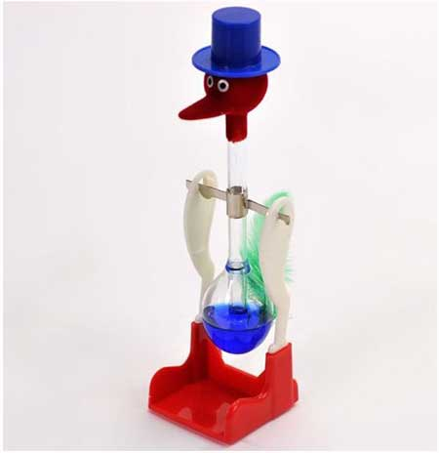
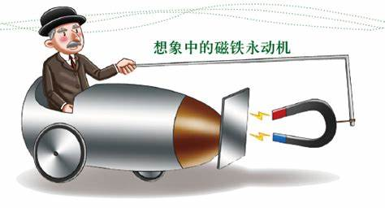
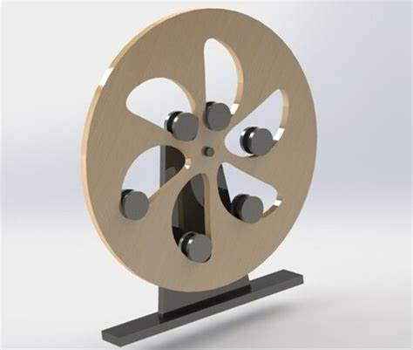
Perpetual motion
Open Question:
Find two different “Perpetual motion machines” from the video, and explain why it is not a real Perpetual motion.
How to make the drink bird to generate electric power
https://v.youku.com/v_show/id_XNDQ3MzEwMzA4.html
https://v.youku.com/v_show/id_XMjI1ODA3ODIw.html

Slide 16
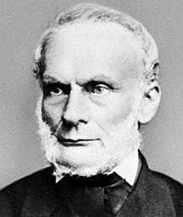
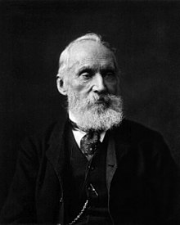
Generally regular of the irreversible process
Other statement of the 2nd law of TD
The principle of Clausius
1850, It is impossible to transfer thermal energy from a cold to a hot reservoir without, in the same process, converting a certain amount of work to thermal energy.
In 1865, Clausius gave the first mathematical version of the concept of entropy, and also gave it its name.
(Rudolf J. E. Clausius,
1822– 1888).
The principle of Kelvin
It is impossible, by means of a cyclic process, to transfer thermal energy from a hot reservoir and convert it to work without, in the same process, transferring thermal energy to a cold reservoir
Lord Kelvin is known for determining its correct value as approximately −273.15 degree Celsius
Lord Kelvin,
aka William Thomson,
1824– 1907
Open question: Is a possible to go beyond −273.15 ºC
Notes:
British nobility: Duke; Marquesses; Earls; Viscount; Baron/Lord;
公爵，侯爵，伯爵，子爵，男爵

Slide 17
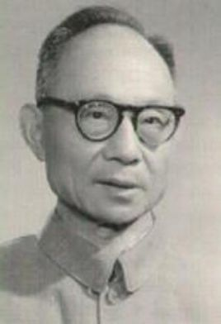
Generally regular of the irreversible process
Other statement of the 2nd law of TD
王竹溪说法
1955， “对于挑选的某一不可逆过程，指明它所产生的效果不论利用什么方法也不能完全恢复原状而不引起其他变化.”
王竹溪
1911-1983
中国热力学统计物理
研究开拓者
Max K. E. L. Planck
不可能造一个机器，在循环动作中把一重物升高而同时使一热库冷却

Slide 18


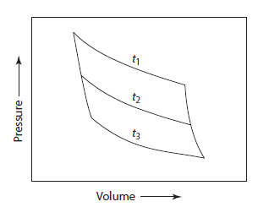
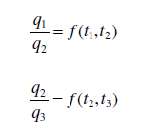







TD temperature scale
Carnot cycle
Since f (t ₁ ,t ₂ ) is independent of t ₃ , then
f (t ₁ ,t ₃ ) and f (t ₂ ,t ₃ ) must be of the form
Kelvin took these functions to
have the simplest possible form—F(t_{i})=T_{i}
This defines an absolute thermodynamic scale of temperature which is independent of the working substance.

Slide 19
Any reversible cyclic process
Any reversible cyclic process can be treated as the sum of a number of Carnot cycles.
The vanishing of the cyclic integral indicates that the integral is a perfect differential of some function of state of the system. This function is called the entropy, S, and is defined as:

Slide 20
5. Entropy
Chapter 3
Introduction to the thermodynamics of materials,
5th or 6th edition, by David R. Gaskell, Talor & Francis Press, 2018

Slide 21
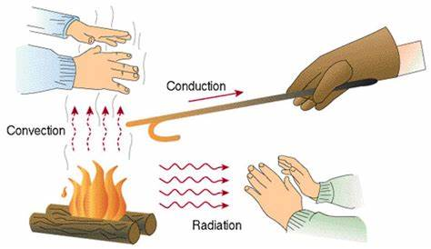
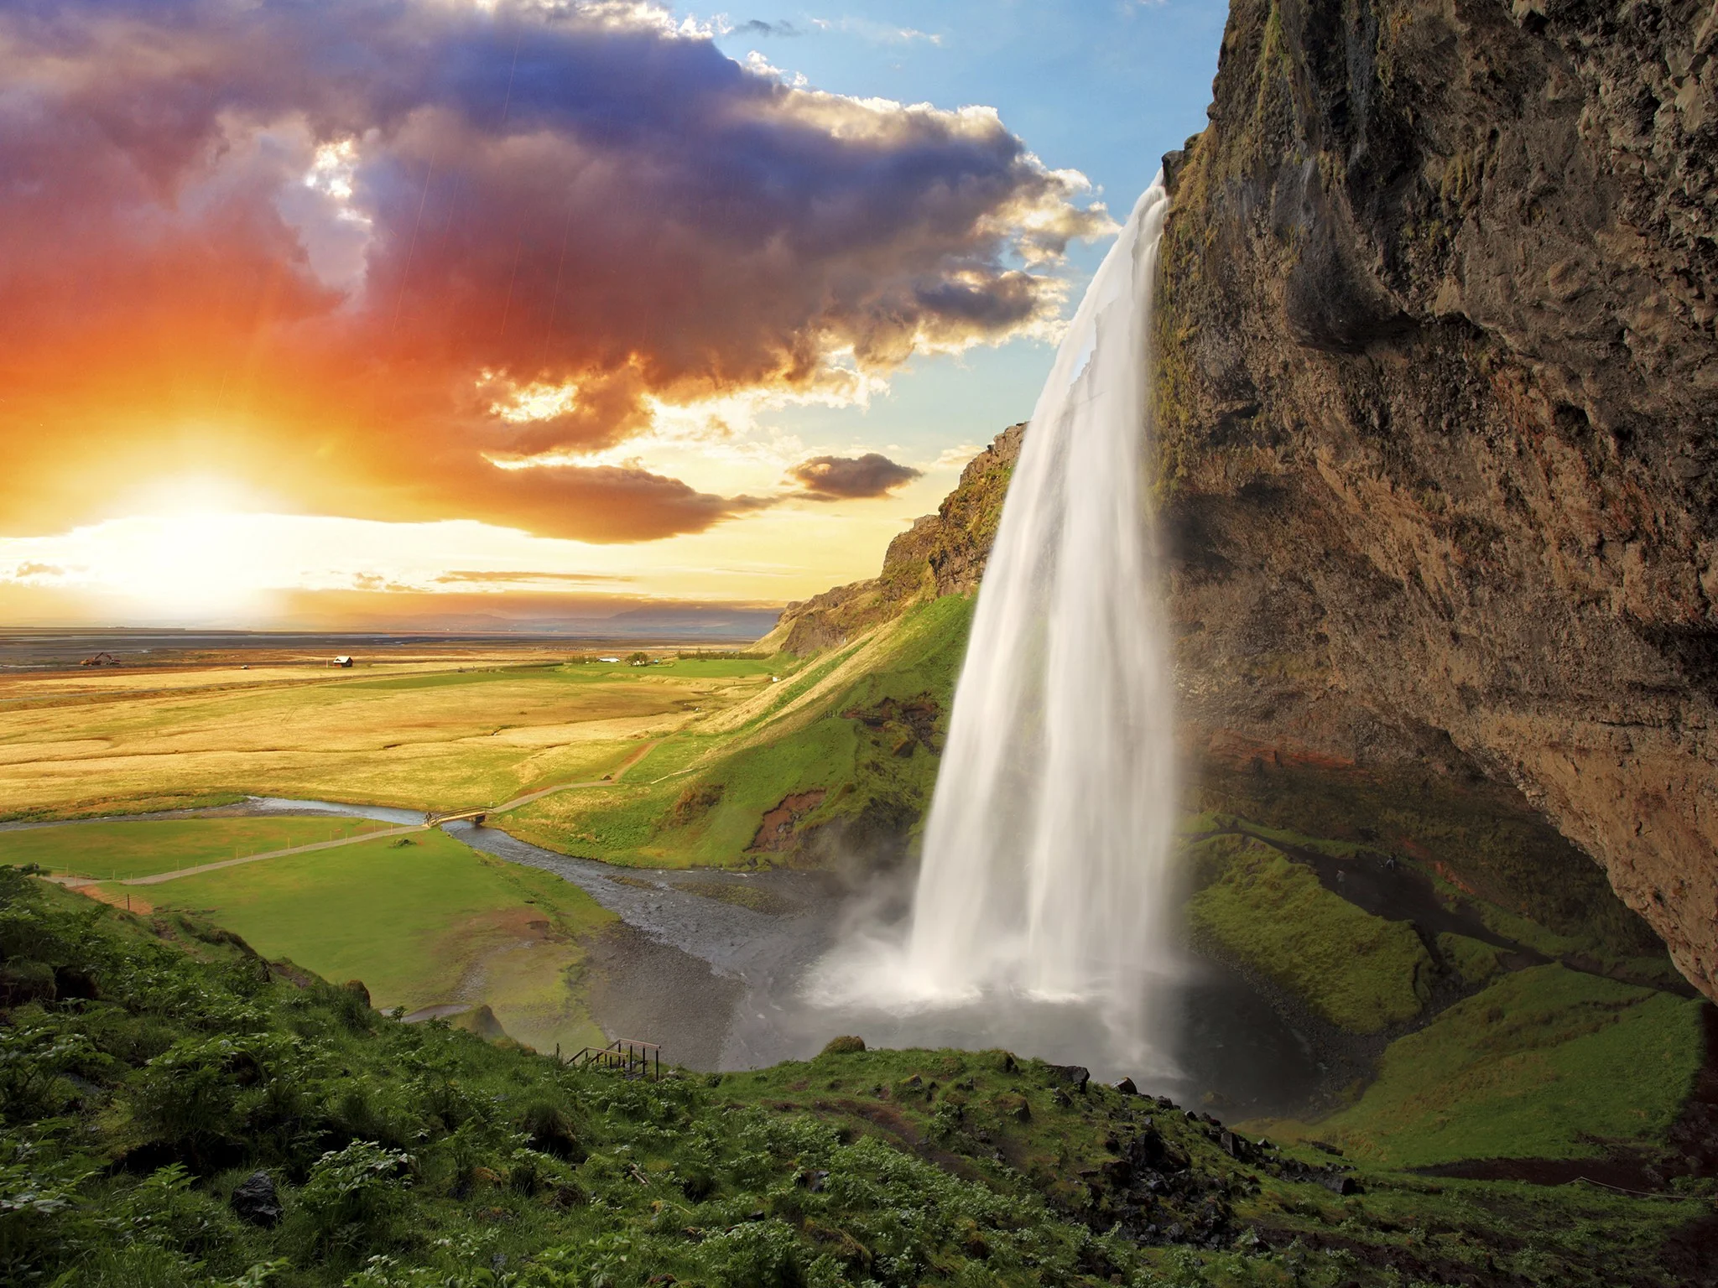
Why we need the concept of entropy?
The heat always flow hot to cold
The water flow high to low

Slide 22
Why we need the concept of entropy?
Irreversible Processes
A system left to itself will do one of two things:
it may remain in the state in which it happens to be
it may change of its own accord to some other state
Natural/Spontaneous Processes
If a system is not initially at equilibrium,
it will tend to move towards its equilibrium state
Entropy, the quantification of the Irreversible Processes

Slide 23

Who give the name of Entropy?
In 1865,
Clausius named the concept of S, "the differential of a quantity which depends on the configuration of the system", entropy (Entropie) after the Greek work for 'transformation'.
“The energy of the universe is constant. The entropy of the universe tends to a maximum.”
Rudolf Clausius
Germany Physicist
(1822-1888)

Slide 24
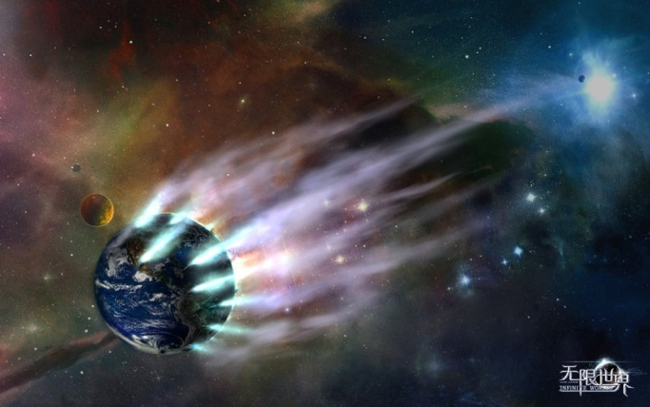
The mathematic form of 2nd law of TD
For close system subjected to spontaneous processes, it will have the change of entropy large or equal to zero
Time is asymmetry !
The beginning of the world should be perfect!
The world might be end up with mess if without “God”!

Slide 25

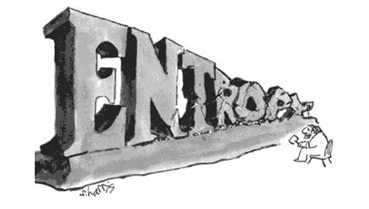
Entropy and Art

Slide 26
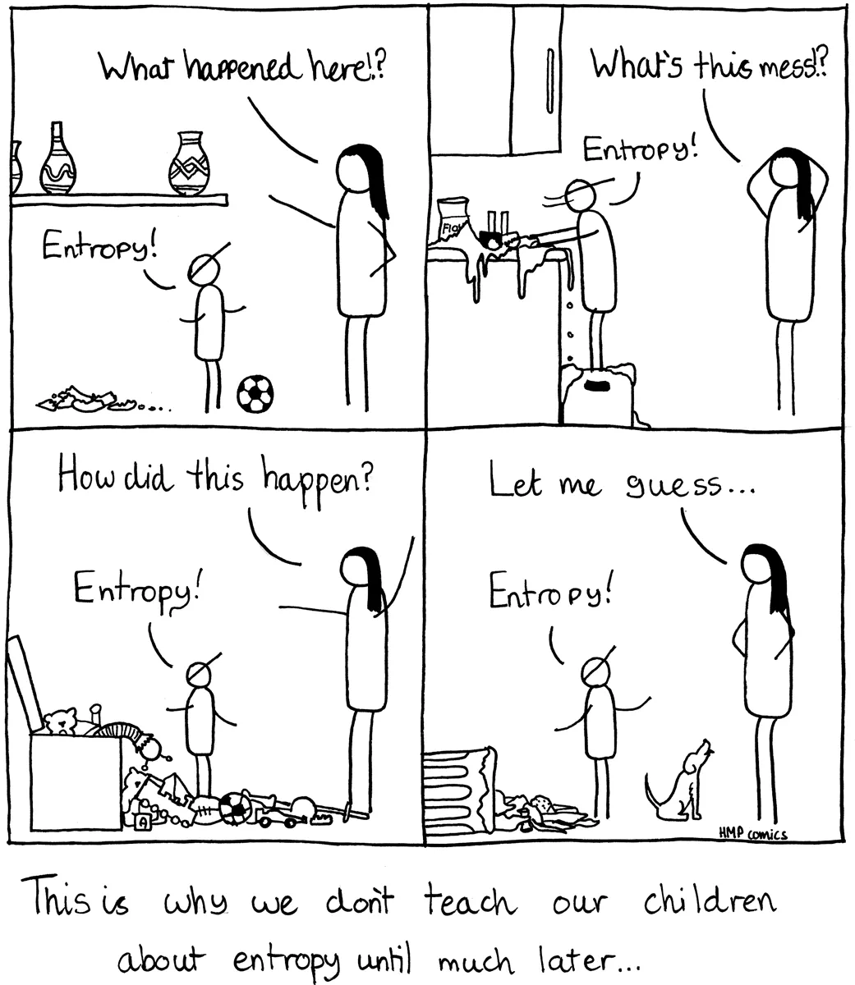
Entropy is every where
A quantity description of loss during the irreversible process!

Slide 27

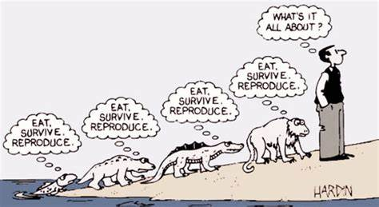
Open question:
If the entropy increase is the time direction,
Why nature life and human being appearing?
The end of the world?

Slide 28
6. Quality of Energy
Ref. Thermodynamics: A Engineering approach, Chapter 8

Slide 29
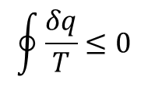
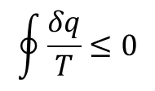
Clausius inequality
For any reversible cyclic process
the sum of a number of Carnot cycles.
For any cyclic process, the cyclic integral of δQ/T is always less than or equal to zero.
$$\oint{\frac{δq}{T}≤0}$$
Clausius inequality
For any process
$$\oint{\frac{δq}{T}≤0}$$
Proc. 1-2
Proc. 2-1
Entropy
change
Entropy
transfer
Entropy
generation
Considering any process from 1-2
Arbitrarily adding an internal
reversible process 2-1
Increase of entropy principle
“the entropy of isolated system during a process always increase”

Slide 30
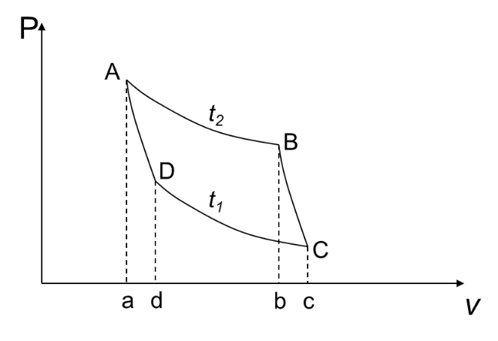
Entropy generation during a heat transfer
A heat source at 800K lose 2000 kJ of heat to a sink at 500K and 750K.
Determine which heat transfer is more irreversible.
Source
（800K）
Source
（800K）
2000 kJ
2000 kJ
Sink
(500 K)
Sink
(750 K)
Furthermore,…
Source
（800K）
Q_{source} =2000 kJ
Heat engine
W= 750 kJ
Q_{sink} =1250 kJ
Sink
(500 K)

Slide 31
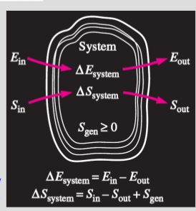
Entropy balance
Increase entropy for any system
Total
Entropy
entering
Total
Entropy
out
Total
Entropy
generation
Changing in the
Total entropy
Of the system
Considering heat engine as system
Source
（800K）
Source
（800K）
Q_{source} =2000 kJ
Q_{source} =2000 kJ
Heat engine
W= 750 kJ
Heat engine
W= 600 kJ
Q_{sink} =1250 kJ
Q_{sink} =1400 kJ
Sink
(500 K)
Sink
(500 K)
Energy and entropy balance for system

Slide 32
The changes of entropy
1st TdS, considering T and V as independent variable
2nd TdS, considering T and P as independent variable

Slide 33
Entropy generated associated with heat transfer
(a) The entropy change of the subsystem Iron
System= lake + iron
Iron is cooling at constant volume condition
Lake
T₂=285K
Iron
m= 50 kg
T₁= 500K
(b) The entropy change of the subsystem lake
Both the water and the iron are incompressible
The temperature of the lake is const.
The energy it receive:
Iron：c_{avg} = 0.45 kJ/kg·K
The entropy of lake:
The generation of entropy:
Where the location of the entropy generated ?

Slide 34
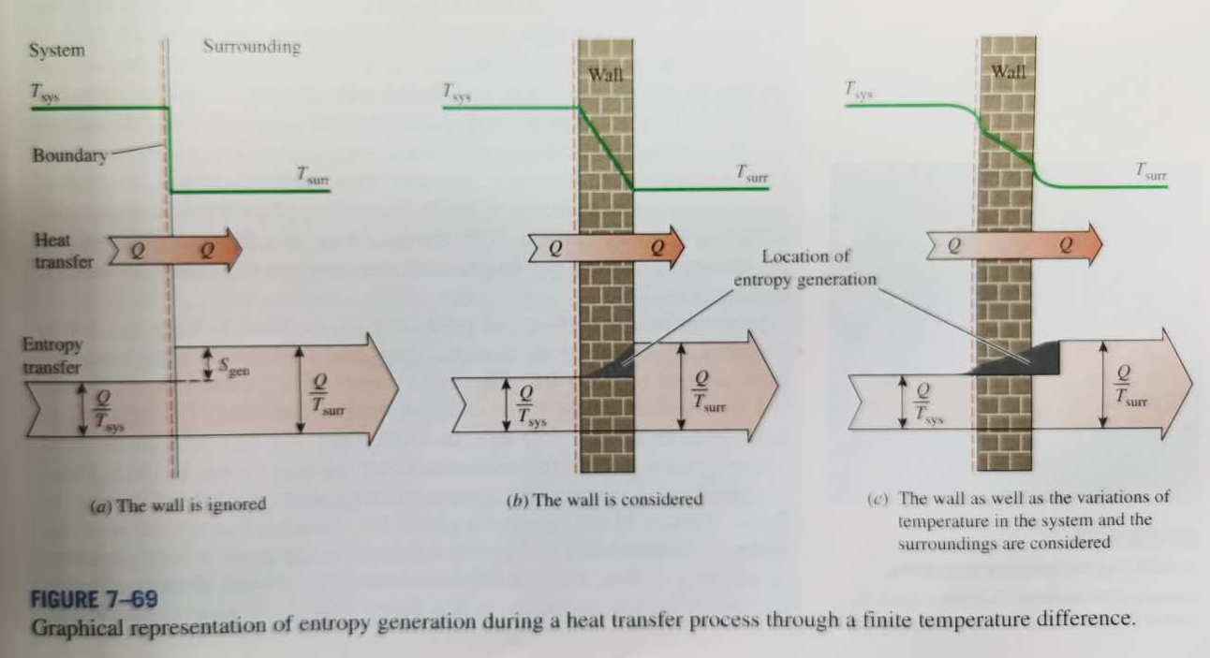
Entropy generated associated with heat transfer
Entropy generated at the heat exchange boundary

Slide 35
Quality of Energy
1st law of TD: quantity of energy → energy cannot be created or destroyed.
2nd law of TD: quality of energy → degradation of energy: entropy increase / lost opportunities to do work → energy has quality as well as quantity.
Exergy (可用能): the maximum useful work that can be obtained from the system at a given state in a specified environment.
The availability of energy !

Slide 36
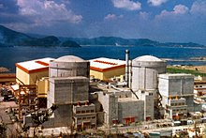
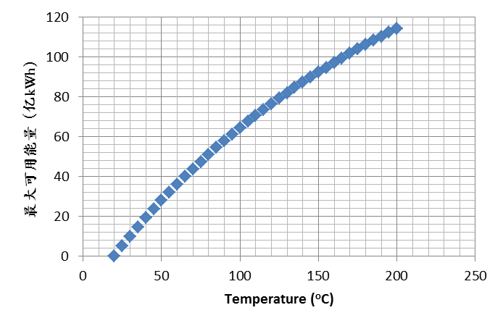
Waste Heat
Nuclear power plant
(大亚湾核电站)
Two 984 megawatt (10⁶ W) Plant
Total electricity per year: ~120亿 kWh
Waste heat released：>300 亿 kWh
Carnot efficiency
30 ºC waste water，Exergy：0.9 billion kWh
40 ºC waste water，Exergy ： 1.9 billion kWh
50 ºC waste water，Exergy ： 2.7 billion kWh
…

Slide 37
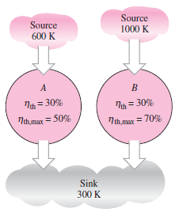




2nd-Law Efficiency η_{II}

Slide 38

2nd-Law Efficiency η_{II}
Schooling and training increase exergy, but aging decreases physical exergy.
Physical exergy and intellectual exergy.

Slide 39
Quality of energy is not conserved.
Energy is conserved. It cannot be destroyed or created.
There should be NO energy crisis.
Quantity of energy is conserved.
Quality of energy is not conserved.
Wasting energy is synonymous to converting it to a less useful form/lower quality.

